Slide 1


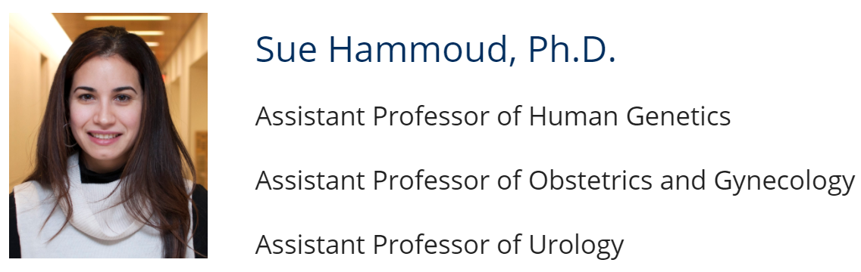
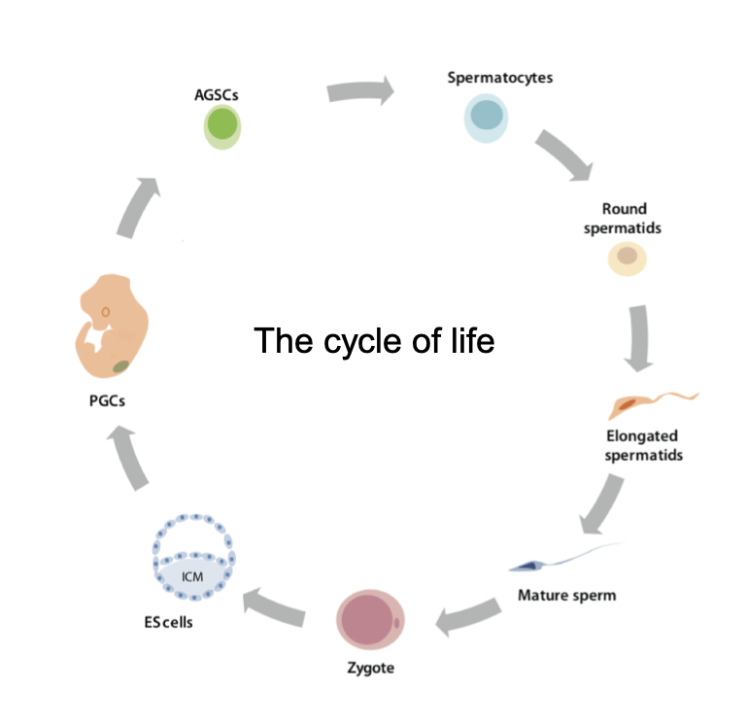
University of Michigan
Yunhao Wang Ph.D.
October 16, 2020
Department of Biomedical Informatics, Ohio State University

Slide 2
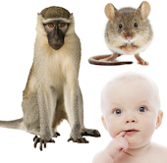
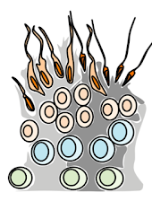
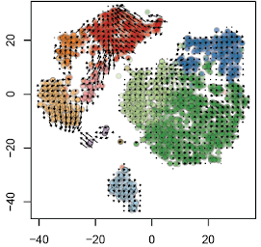
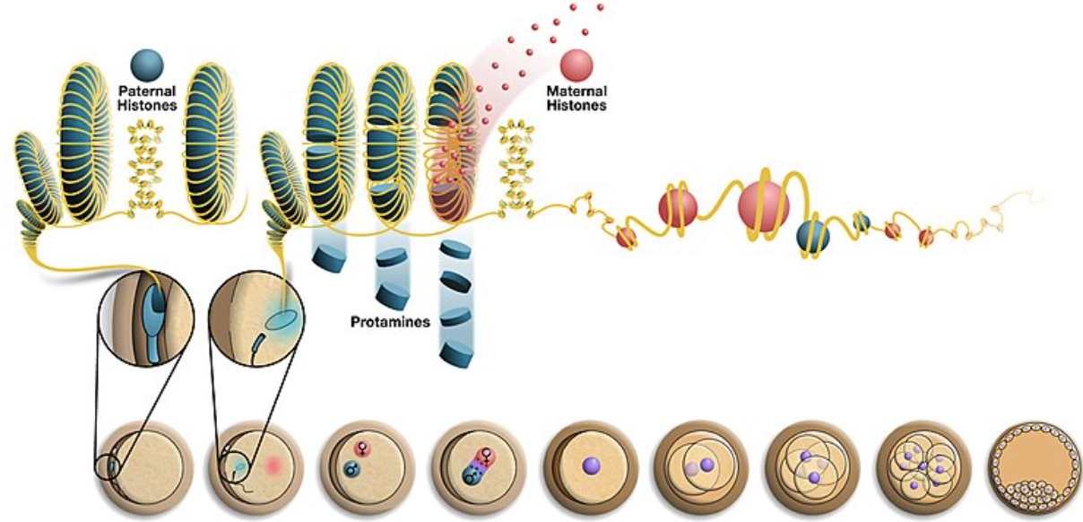
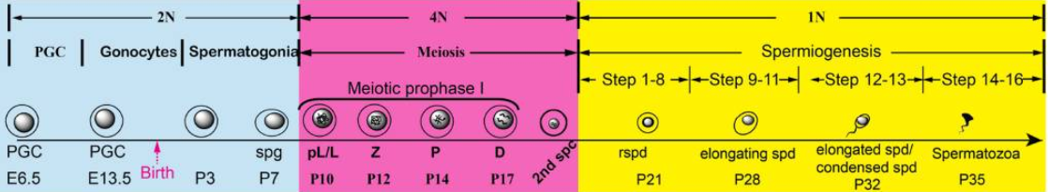
Research @ Hammoud Lab
Molecular mechanisms and pathways required for proper germ cell development (single-cell + lineage tracing techniques)
Germ cell comparative biology
Dissecting germ cell-soma communication
Making somatic cells of the testis
Contribution of the male germline chromatin to development and disease (genetic, genomic and biochemical techniques)
Protamine (small arginine-rich, sperm-specific nuclear protein): structure vs function
Epigenetic inheritance:
1) “histone-to-protamine transition” 2) “protamine to histone exchange” after fertilization
Toroid (50 kb)
Spermatogenesis
Histone-to-protamine
Maternal nucleosome (147 bp)
Paternal nucleosome (147 bp)
Bao, J. and M. T. Bedford, Reproduction (2016); https://en.wikipedia.org/wiki/Protamine

Slide 3
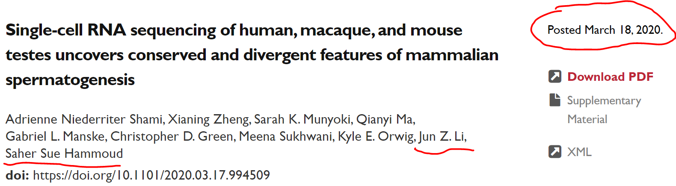
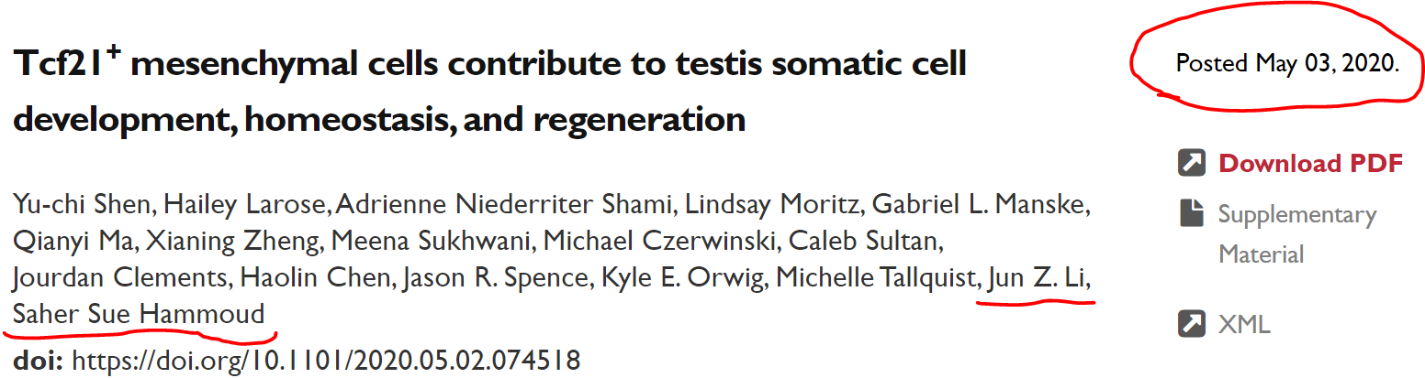
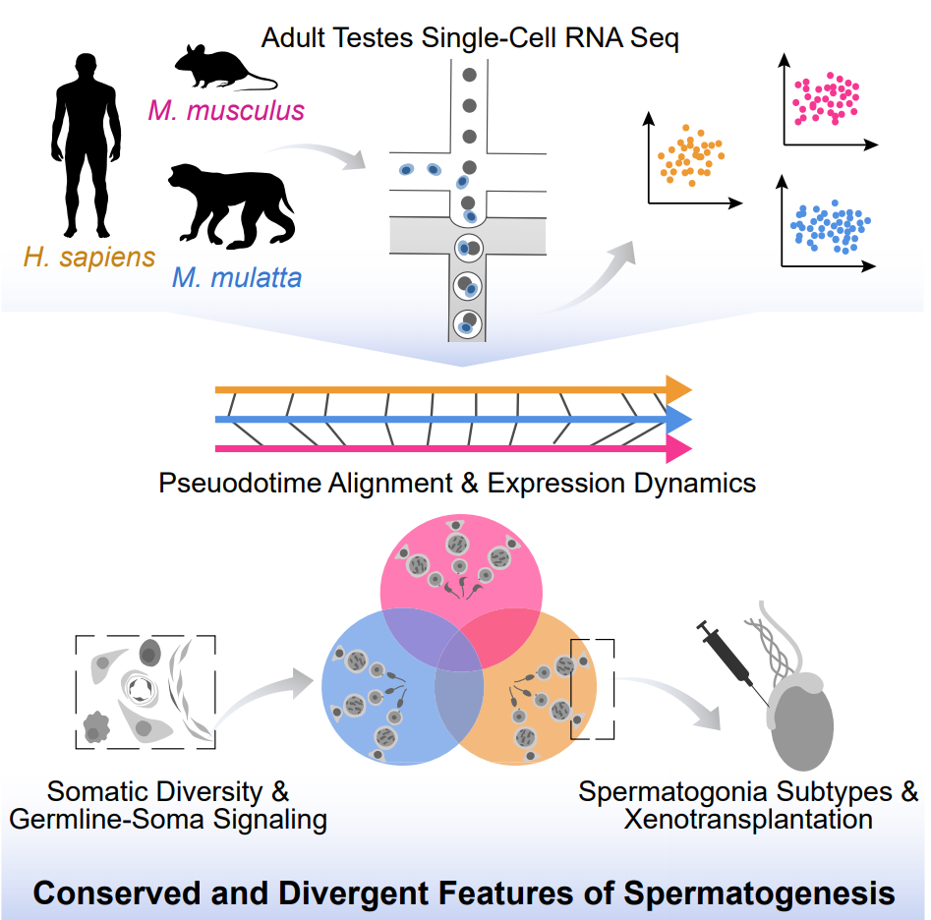
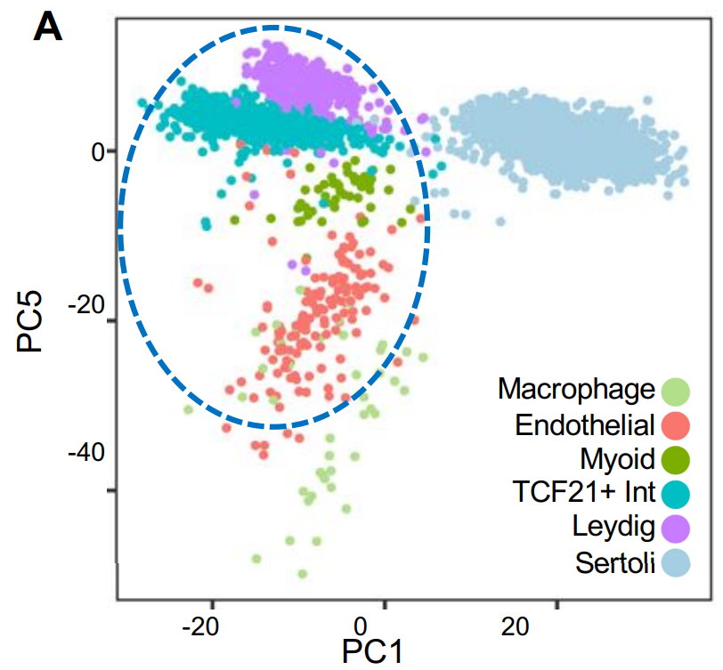
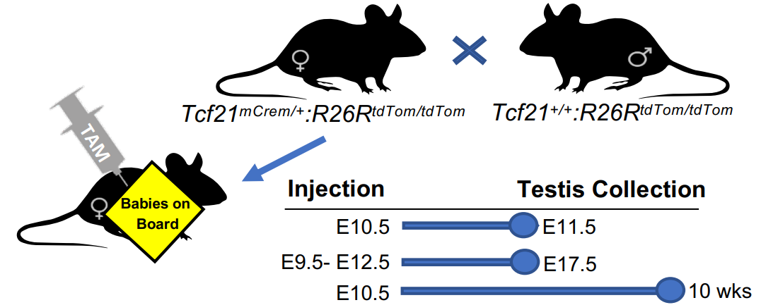
Tcf21+ cells
What is the origin
Mesenchymal by DEG + GO analyses
What is the property/function
Multipotent somatic stem cell (to Leydig and myoid)
Somatic lineages in the male gonad
Multiple fetal and adult ovarian somatic cell types
Regenerate somatic cell types in the adult mouse testis
Somatic turnover in the testis during aging
Resembles resident fibroblast populations in other tissues
Genetic lineage tracing

Slide 4

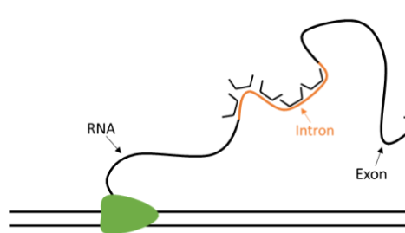
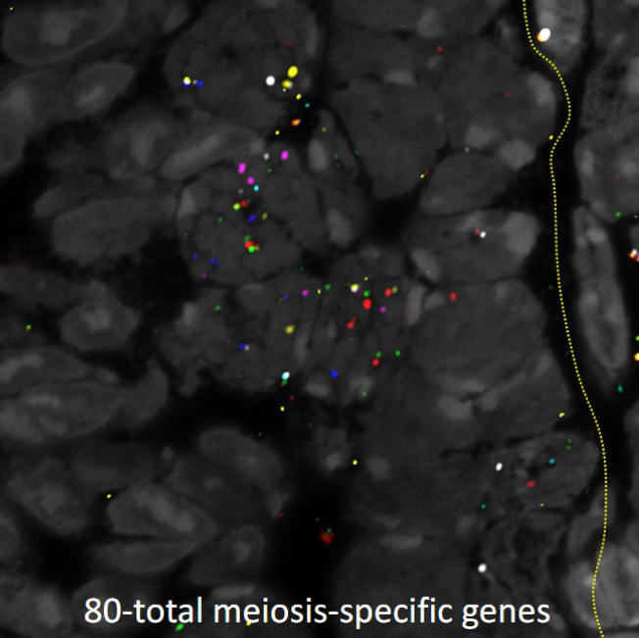
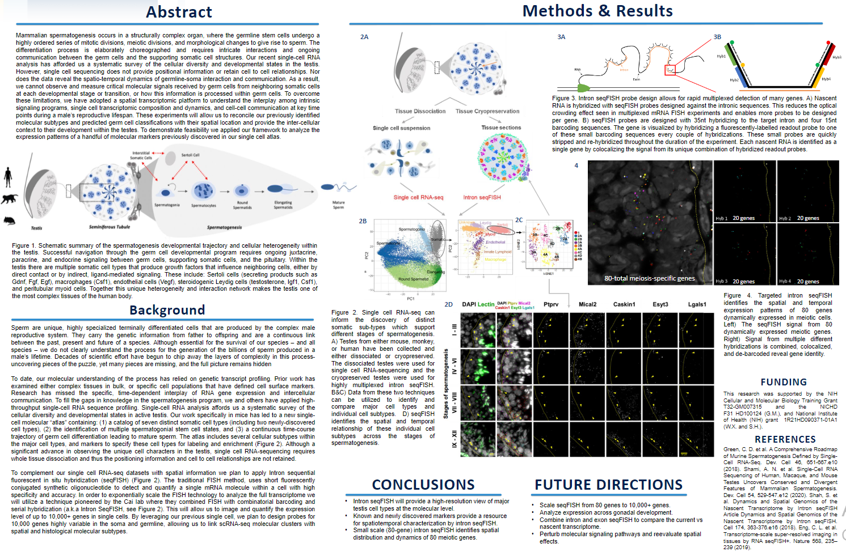
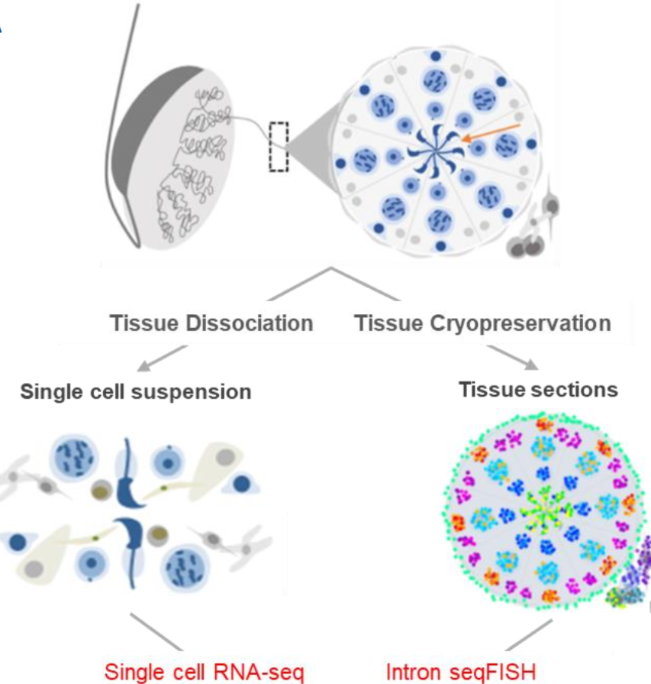

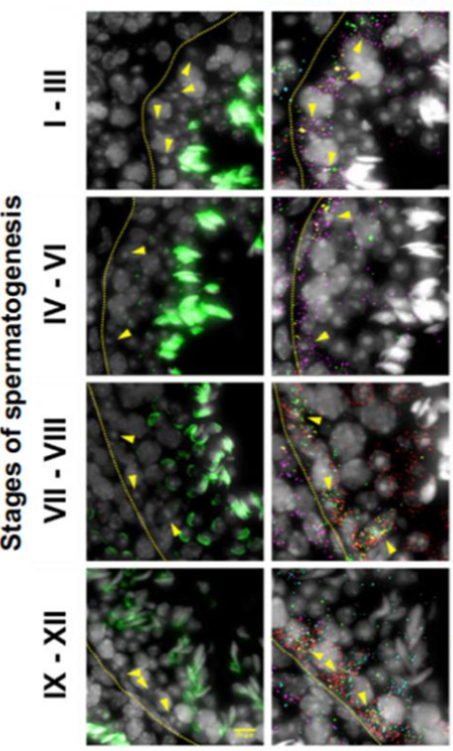
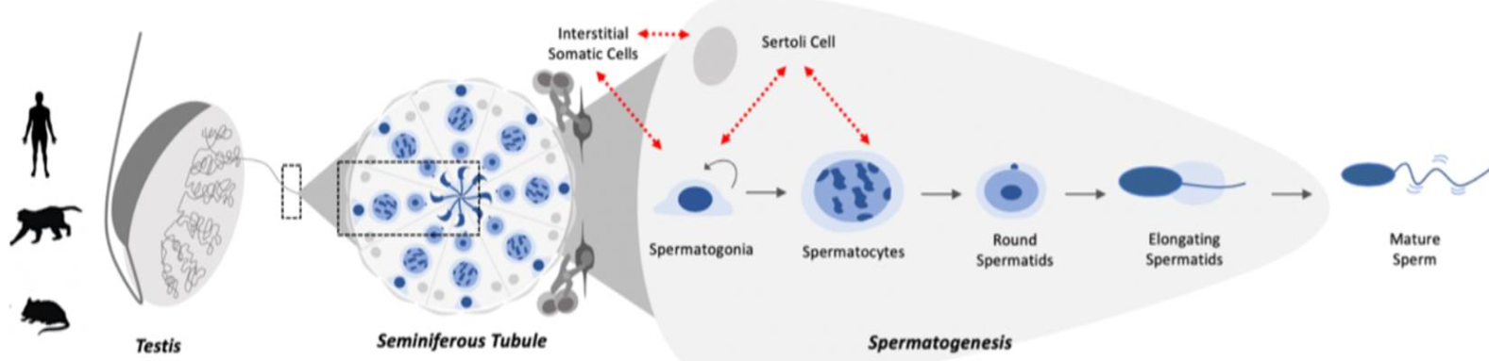
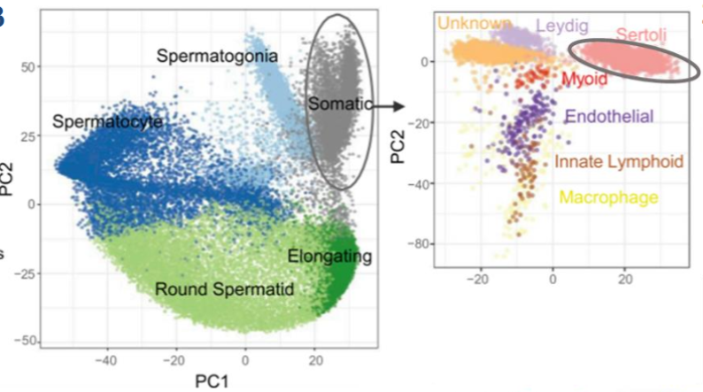
Intron sequential fluorescent in situ hybridization
QUESTION: the spatial communication between germ cell and somatic cell during germ cell development

Slide 5

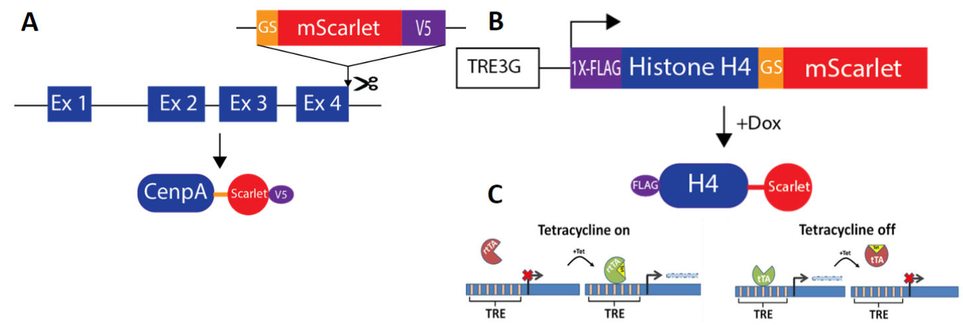
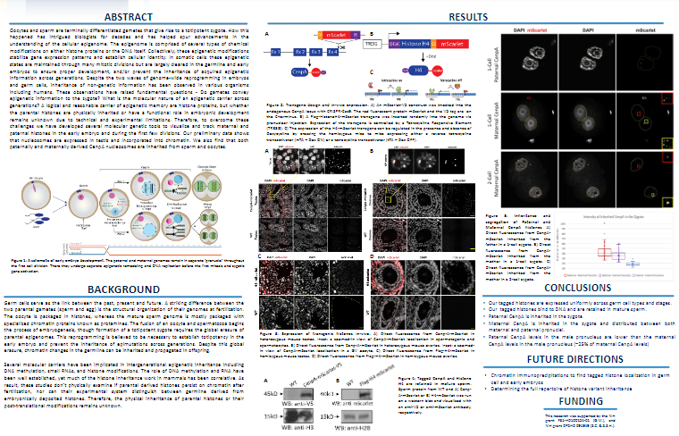
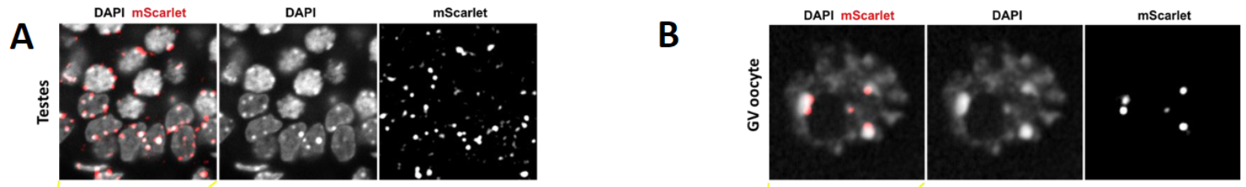
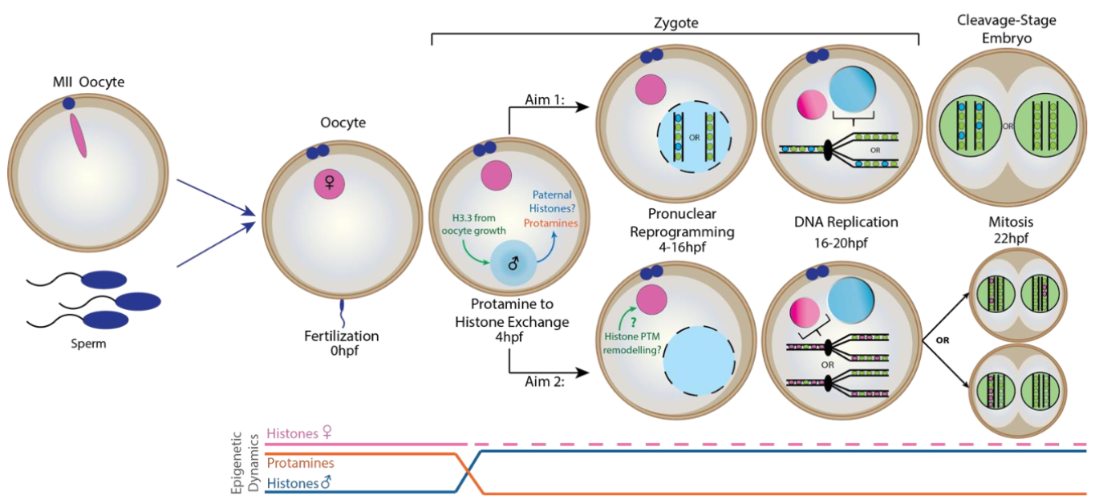
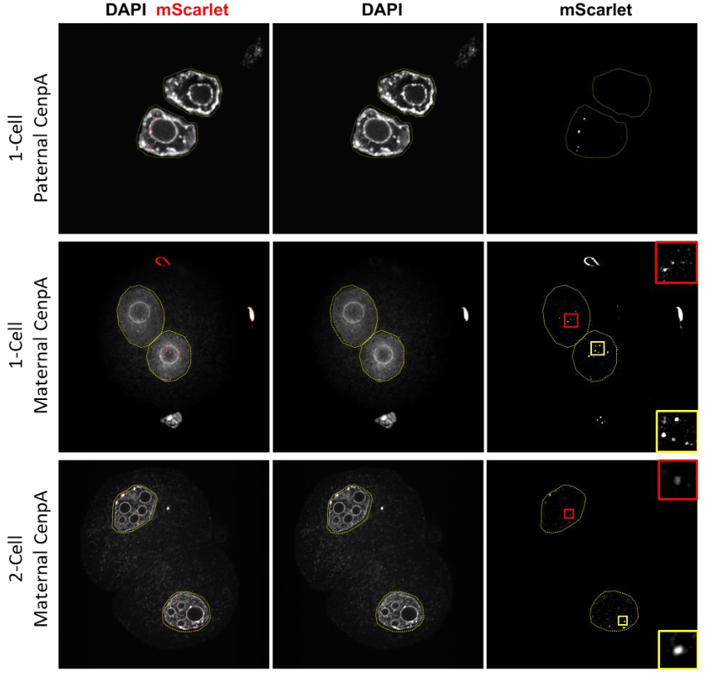
Testes/Sperm Ovaries/Oocyte
Fertilization
1-cell (Paternal)
1-cell (Maternal)
2-cell (Maternal)
QUESTION: during early development
1) “Protamine to histone exchange” ; 2) Histone PTM remodeling

Slide 6
Thanks

